Slide 1
Cellular Level of Organization (cell membranes & transport)

Slide 2
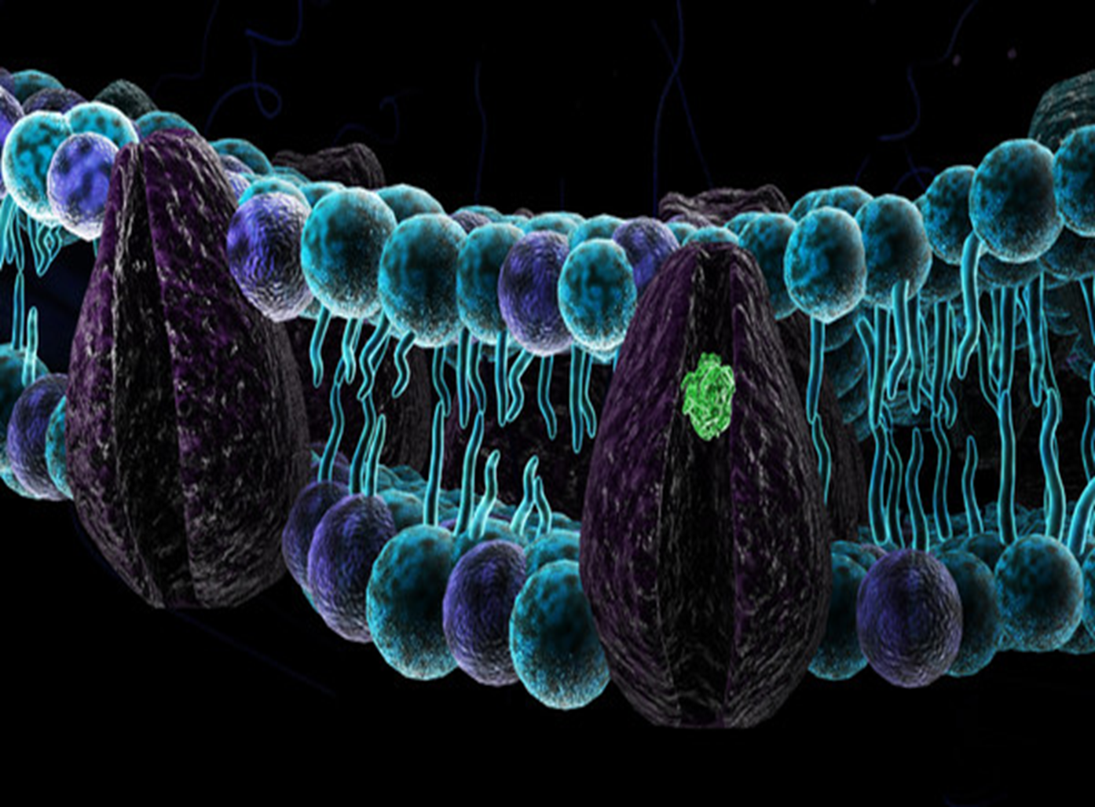
Mammalian cell membrane

Slide 3
Functions:
Physical isolation/ barrier that separates ICF from the surrounding ECF
Regulation Highly selective for exchange from/into the cell with the environment (ions, nutrients, wastes, secretions)
Structural support: attachment point for intracellular cytoskeleton (cell framework): internal network of protein filaments and microtubules that controls the cell's shape and movement.
Sensitivity :contains receptors, affected by changes in ECF (pH, concentration, composition)

Slide 4
Structure: Fluid Mosaic Model
Cell membrane is a Fluid Mosaic of
Proteins,
phospholipids, cholesterol, other lipids,
carbohydrates
Phospholipid bilayer: Bilayer of lipids with imbedded and dispersed proteins
Flexible, thin, elastic but sturdy barrier that surround the cytoplasm:6-10nm
Semipermeable
Present in all cells

Slide 5
Structure: Membrane lipids
Two back-to-back layers of 3 types of lipid molecules: phospholipids (75%), cholesterol (20%), and glycolipids (5%)
Phospholipids
- form the bilayer with Cholesterol and glycolipids scattered among a double row of phospholipid molecules
have hydrophobic(fatty acid end) and hydrophilic (phosphate end) bipoles.
lie with their hydrophilic heads at the membrane surface and hydrophobic tails on the inside
Entire membrane is held together by noncovalent interaction of hydrophobic tails

Slide 6
Glycolipids:
Carbohydrate groups form a polar head only on the side of the membrane facing the extracellular fluid
Cholesterol:
Interspersed among the other lipids in both layers
Hydrocarbon tails are nonpolar and hide in the middle of the cell membrane

Slide 7
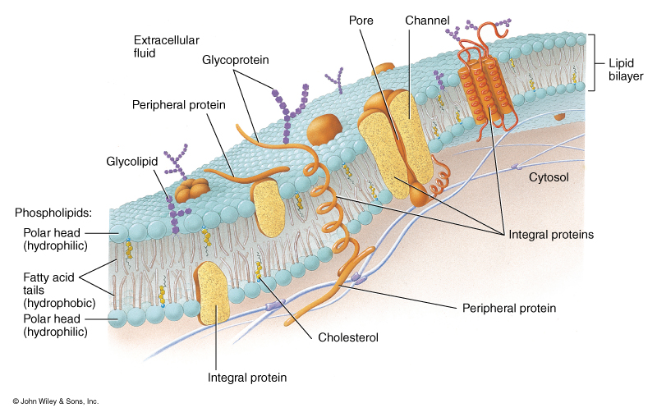
Lipid Bilayer of the Cell Membrane

Slide 8
Structure: Membrane proteins
About 55% of the cell membrane weight
2 major types: integral and peripheral
Integral (transmembrane) proteins:
- span width of membrane 1/more times (embedded)
- Their hydrophobic ends completely span the hydrophobic interior of membrane, whiles hydrophilic ends are exposed to aqueous parts on either side of the membrane
Peripheral proteins:
- Bound to inner or outer surface of membrane(not embedded)

Slide 9
Membrane Proteins

Slide 10
Functions: plasma proteins
Anchoring proteins-attach membrane to other structures to stabilize its position ie to cytoskeleton and extracellular matrix
Recognition proteins: identifiers, cells of immune system recognise others as normal/abnormal(Cell-cell recognition)
Receptors: sensitive to ligands, for signal transduction
Carrier proteins: binds solutes and transports them across the membrane
channels: contains a central pore, serves as a passageway for movement of water and small solutes(eg ions)-leak and gated channels
Enzymes: Enzymatic activity
Antigens

Slide 11
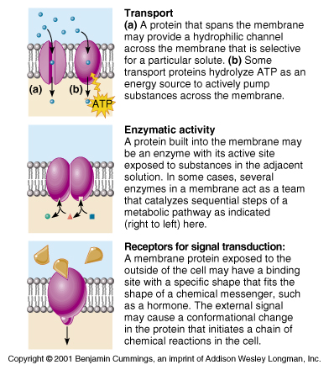

Slide 12
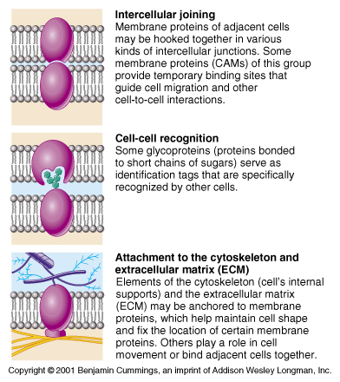

Slide 13
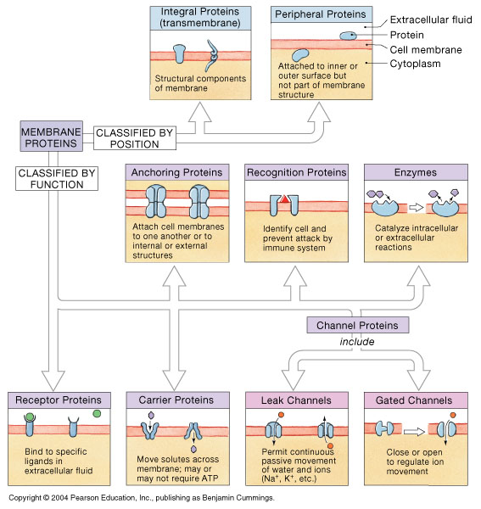
Classification: Membrane proteins

Slide 14
Structure: Membrane carbohydrates
About 3% of the membrane weight
Components of complex molecules
Covalently bonded to lipids to form glycolipids and to Proteins, forming glycoproteins
Forms a layer by extending beyond the outer surface of the membrane-glycocalyx

Slide 15
Functions
Lubrication and protection: form a viscous layer
Anchoring and locomotion: components are sticky, anchoring the cell in place
Receptors: specificity towards extracellular components
Recognition: immune responses

Slide 16
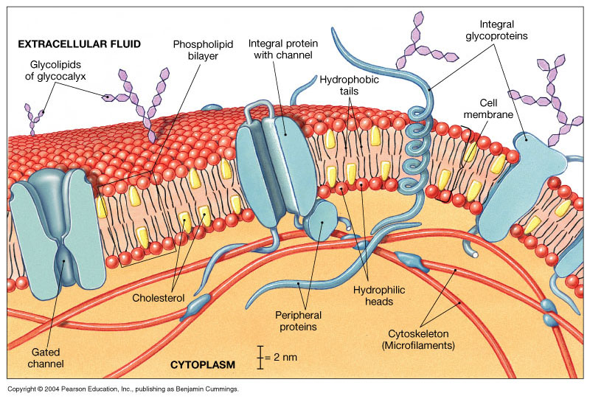
The Cell Membrane: Fluid Mosaic Model

Slide 17


Slide 18
membrane transport processes

Slide 19
Why Transport?.......
…..When mammalian cells are surrounded by a phospholipid bilayer, which is selectively permeable, impermeable to most essential molecules) and existing concentration gradients
Most polar or charged substances, small hydrophilic, macromolecules (proteins, RNA) and ions cannot cross freely
Cell membranes serve as barriers and a gateway between the cytoplasm and extracellular fluid (ECF)
Without membrane transport, cells would quickly lose viability.
All cells acquire molecules and ions that are essential from their surrounding ECF (unceasing traffic that cannot be broken)

Slide 20
Importance of membrane transport:
Different transport systems are required to:
Maintain homeostasis (stable internal environment)
Regulate ion gradients (Na⁺, K⁺, Ca²⁺) critical for nerve and muscle function
Allow nutrient uptake (e.g., glucose, amino acids)
Remove metabolic waste (e.g., urea, CO₂)
Enable cell signaling and volume control

Slide 21
Factors that affect transport
Selective Permeability depends on:
Relative solubility of particle in lipids
Size of particle
Electric charge
Molecular shape
Combination of factors

Slide 22
Membrane Transport
Passive transport mechanisms require no ATP
no expenditure of energy by the cell
Rather the random molecular motion of particles provides the necessary energy
Active transport mechanisms consumes ATP
Active-requires energy(ATP) expended from the cell

Slide 23
Membrane Transport
Passive transport mechanisms require no ATP
no expenditure of energy by the cell
Rather the random molecular motion of particles provides the necessary energy
Active transport mechanisms consumes ATP
Active-requires energy(ATP) expended from the cell

Slide 24
Substances move across the cell membrane in 4 ways:
Directly through the lipid bilayer
Through membrane channels
With carrier molecules in the membrane
In vesicles
Transport mechanisms could be carrier mediated or not.
Mechanisms of Transport:
Diffusion (passive)
Osmosis (passive)
Filtration (passive)
Vesicular transport(active)
Active transport (active)

Slide 25
Carrier mediated transport
Requires the use of specialized integral membrane proteins to transport substances
Moves large water-soluble and electrically charged molecules
Co-transport (symport): Carries two or more solutes simultaneously in same direction
Countertransport (antiport):Carries two or more solutes in opposite directions
Uniport: Carries only one solute at a time

Slide 26
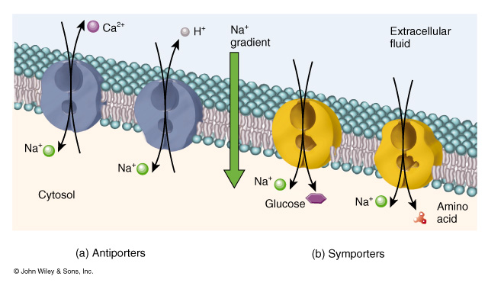
Integral membrane: Antiporters and Symporters
One in & one out. Both going in

Slide 27
Carrier mediated transport: characteristics
Specificity: each carrier binds to and transports only a single type of molecule (specific for one particular ligand)
Solute binds to a specific receptor site on carrier protein
Carriers do not chemically change their ligand (picks them up on one side of the membrane, and releases them, unchanged, on the other)

Slide 28
Competition: results from several similar molecules binding to a carrier/ subs in greater concentration / that which binds more readily
Saturation: rate of transport is limited by the no of available carrier molecules.
As the solute concentration rises, the rate of transport rises, but only to a point—transport maximum (Tm)
Eg. facilitated diffusion, secondary active transport

Slide 29
Diffusion

Slide 30
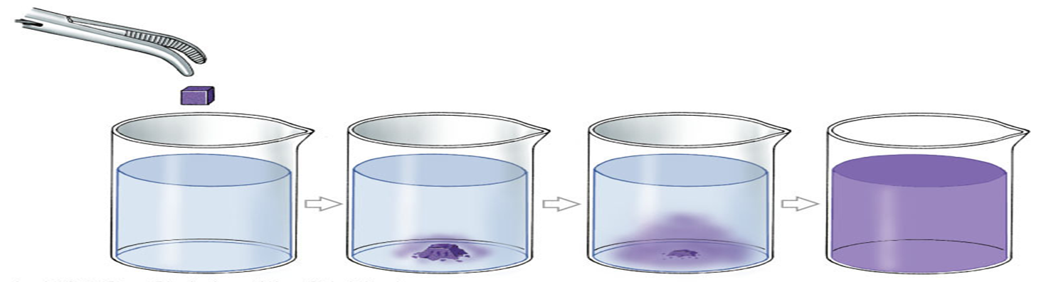
Random movement of molecules with a net direction towards regions of lower concentration in order to reach an equilibrium
Movement is from an area of high concentration to low
Continues until concentration gradient is eliminated
Molecular motion continues, but net movement is not in any particular direction

Slide 31
Principles of Diffusion
More molecules move away from an area of high concentration to an area of low concentration
the greater the difference in concentration between the 2 sides of the membrane, the faster the rate of diffusion
the higher the temperature (solution), the faster the rate of diffusion
the larger the size of the diffusing substance, the slower the rate of diffusion
an increase in surface area, increases the rate of diffusion
increasing diffusion distance, slows rate of diffusion
When the molecules are evenly distributed, equilibrium has been reached

Slide 32
Factors that influence diffusion rates:
Distance: Conc. gradients are eliminated quickly over short distances(shorter time required)
Gradient size: the larger the gradient, the faster diffusion proceeds
Molecule size: ions & small organic molecules diffuse faster than large proteins
Temperature: higher temp, faster diffusion rate
Electrical forces :
Concentration /chemical gradient and electrical grad. Favour diffusion of +vely charged ions into the interior of the cell
Diffusion of –vely charged ions is opposed by the electrical grad. but favoured by the chemical gradient (electrochemical gradient)

Slide 33
Diffusion is either simple or facilitated*
Diffusion is by: Passage through membrane channel
Gated channels:
voltage
chemical (ligand)
mechanical
Light
Non gated channels

Slide 34
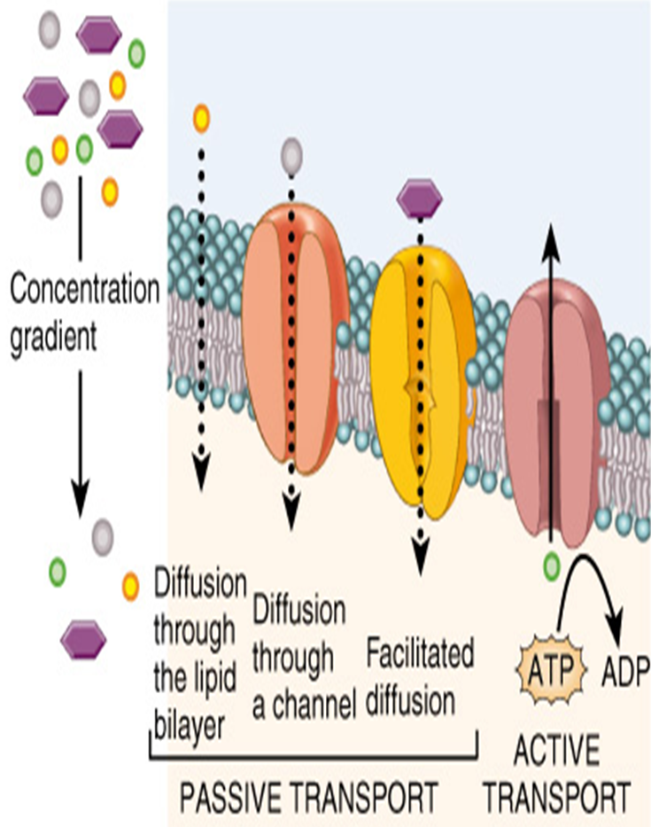
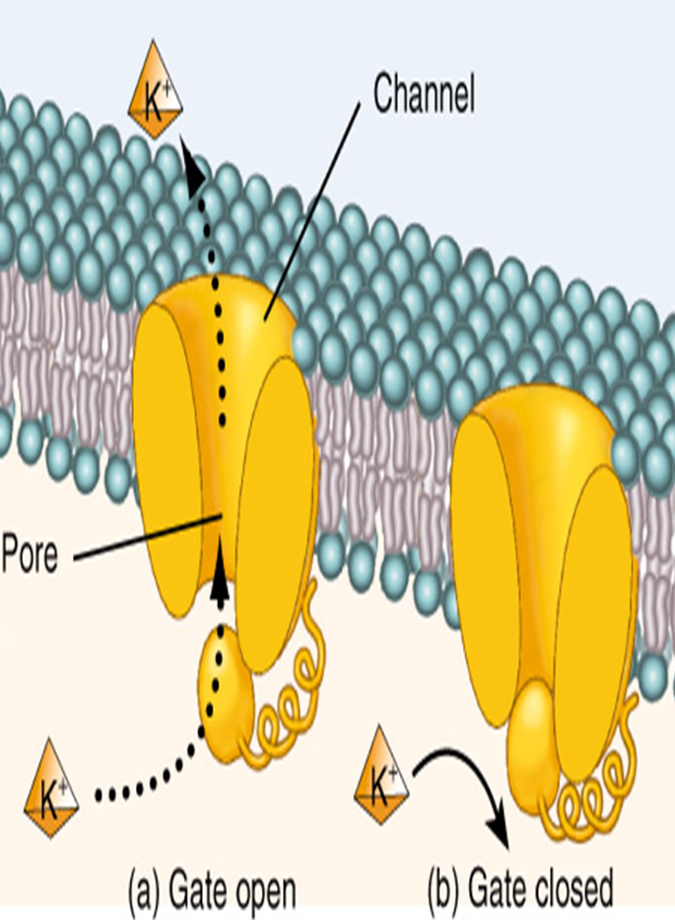
i. Non gated channels
ii. Gated channels

Slide 35
Simple Diffusion
It is the net movement of particles from area of high concentration to area of low concentration passing through the cell membrane without the aid of an intermediary (integral carrier protein).
Movement is always down the concentration gradient, can be
Directly through the lipid bilayer (Nonpolar, hydrophobic, lipid-soluble substances )
Through channel proteins (Water and charged, hydrophilic solutes, small polar / lipid insoluble substances)

Slide 36
Cells control permeability by regulating no of channel proteins or by opening and closing gates
Factors affecting diffusion rate through a membrane
Temperature: ↑ temp., ↑ motion of particles
Molecular weight: larger molecules move slower
Steepness of concentrated gradient: ↑difference, ↑ rate
Membrane surface area: ↑ area, ↑ rate
Membrane permeability: ↑ permeability, ↑ rate

Slide 37
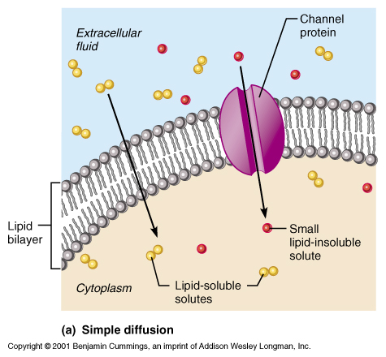
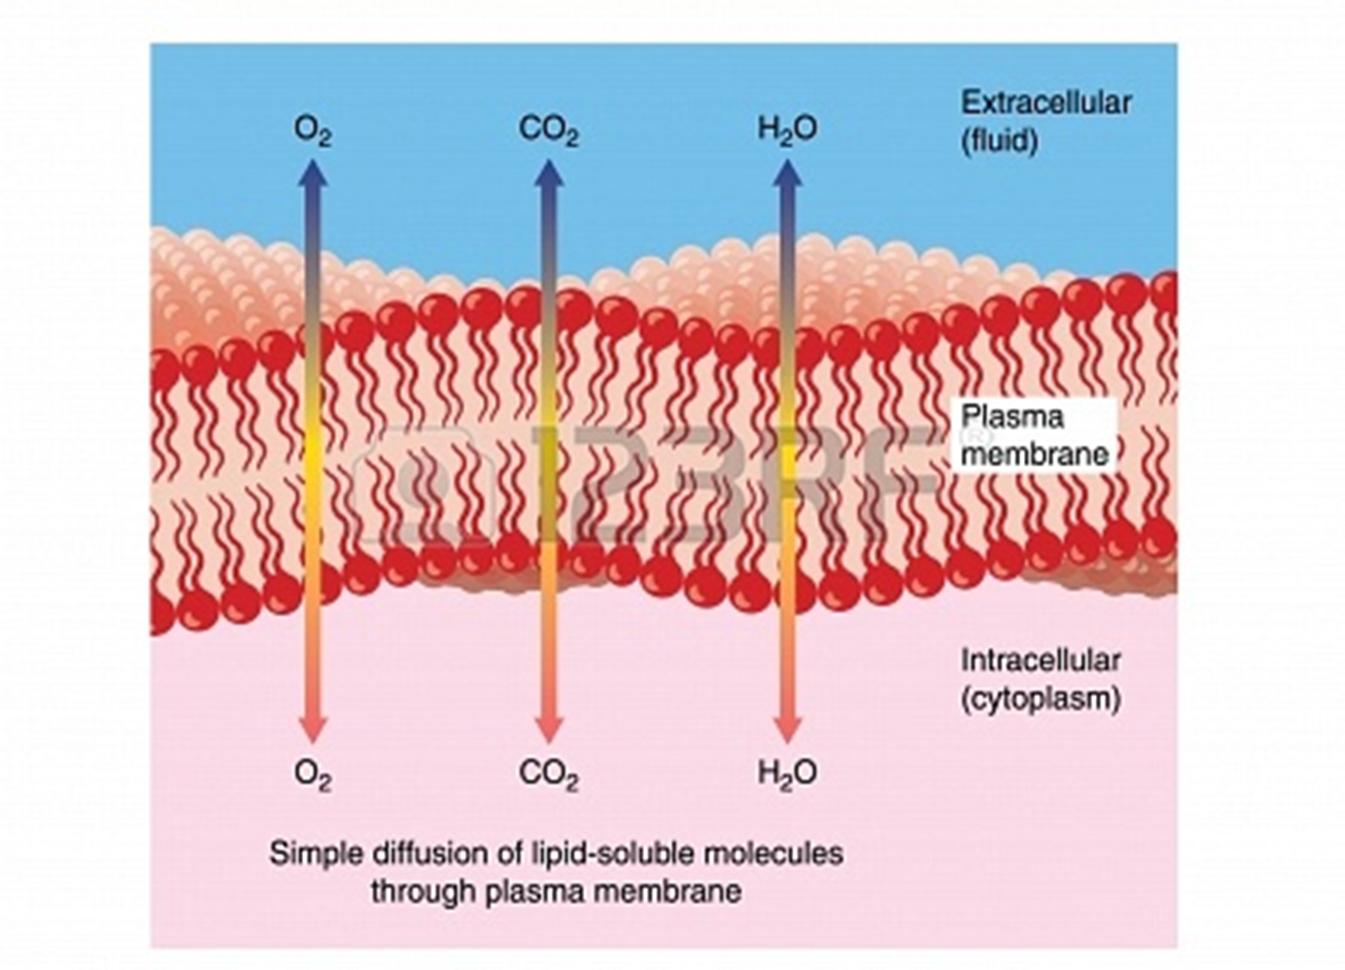
Simple Diffusion

Slide 38
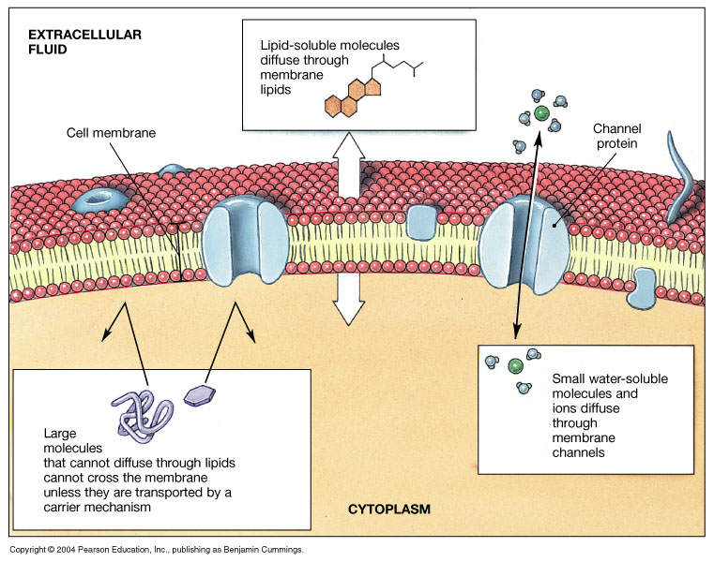
Diffusion across the Cell Membrane

Slide 39
Facilitated Diffusion
Takes place through transmembrane proteins (TP).
TP can either form water filled channels allowing ions to be transported or function as carrier proteins for solutes to bind
Ions:
Channels are opened according to the needs of the cell
Net influx is down an electrochemical grad
Solutes:
Bind to a specific a receptor site on a transporter protein
Protein undergoes a conformational change moving substance across cell membrane
Eg. large, polar molecules (simple sugars)

Slide 40
Characteristics: Proteins show
Specificity
Saturation limits
Regulation
Rapid than simple diffusion
Rate of movement depends upon
steepness of concentration gradient
number of transporter proteins (saturation)

Slide 41
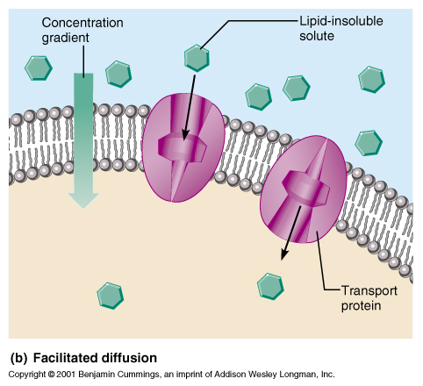
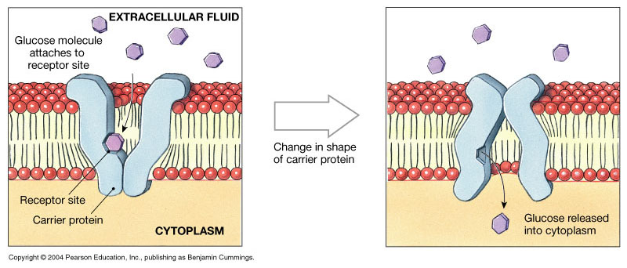

Slide 42
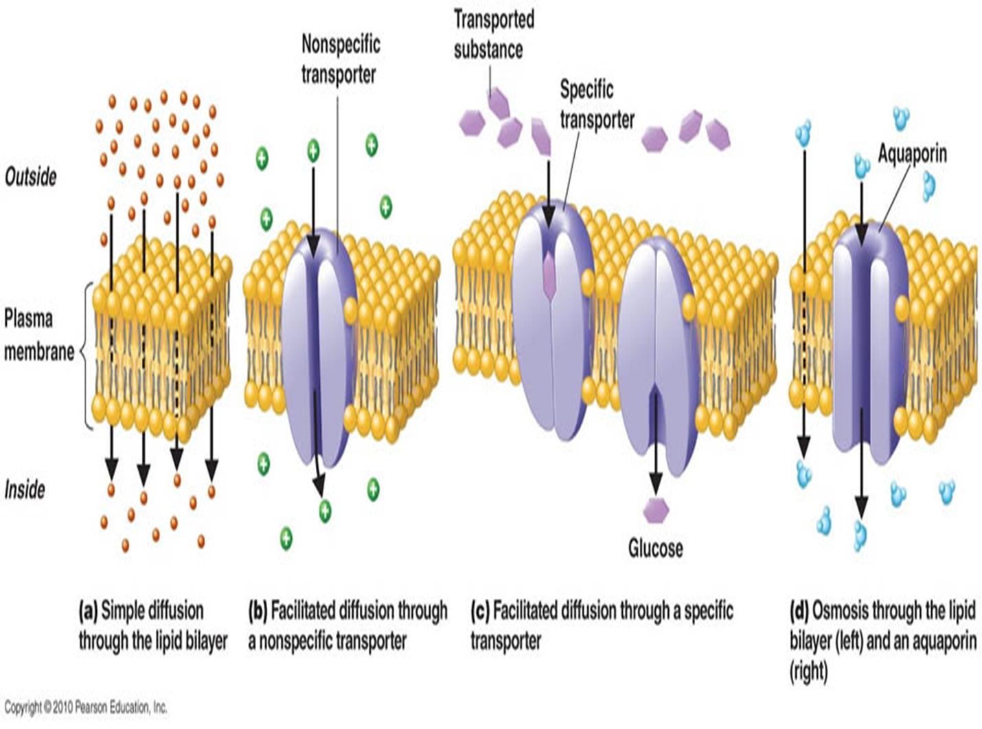
Diffusion

Slide 43
Osmosis

Slide 44
Osmosis
Osmosis is the passive diffusion of water (solvent) across a semipermeable membrane in response to solute differences ( from a low solute concentration to a high solute concentration)
Net movement of water through a selectively permeable membrane from an area of high H₂O concentration to an area of lower H₂O concentration
Aquaporins (transmembrane proteins) function as water channels
Only occurs if the membrane is permeable to water but not to certain solutes

Slide 45
Osmosis generates Osmotic and Hydrostatic pressures
Osmotic pressure is the force required to prevent the movement of water by osmosis
Osmotic pressure is also defined as the Hydrostatic pressure (“water-stopping”) required to stop the flow of H₂O
opposes osmotic force
Equal to the force of H₂O movement into a solution
Dependent on the number of particles in solution

Slide 46
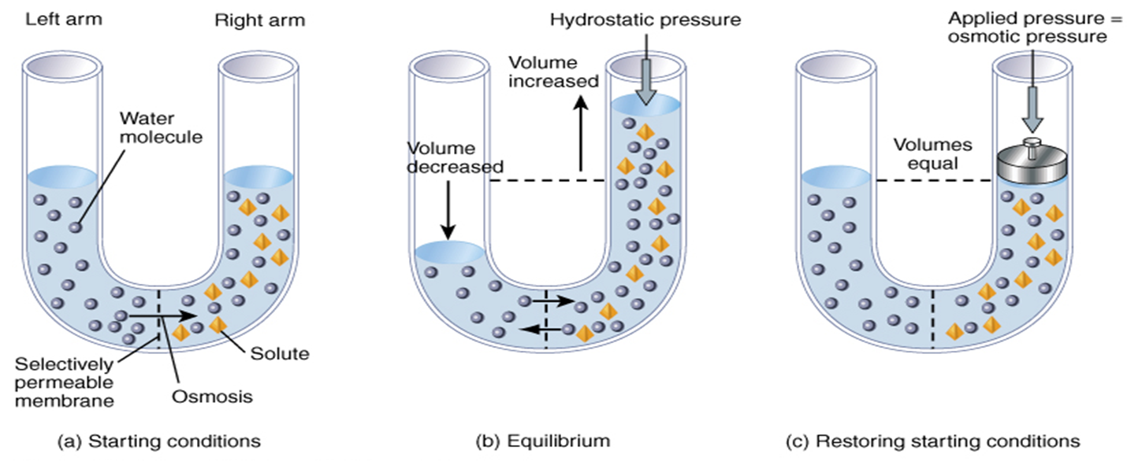
Pure water on the left side & a membrane impermeable to the solute found on the right side
Net movement of water is from left to right, until hydrostatic pressure (osmotic pressure ) starts to push water back to the left
Osmolarity – total concentration of solute particles in a solution

Slide 47
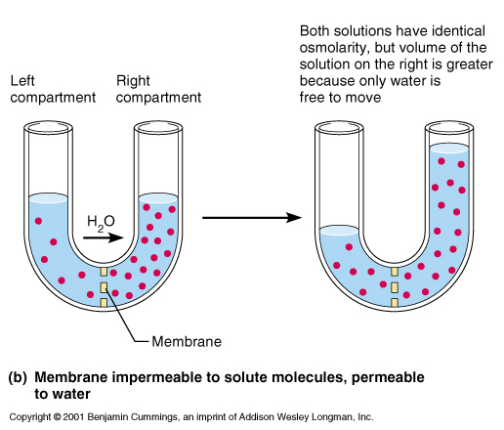
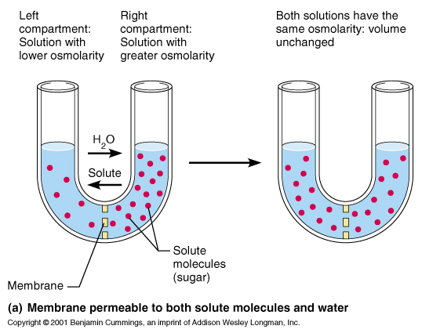
Effect of Membrane Permeability on Diffusion & Osmosis

Slide 48
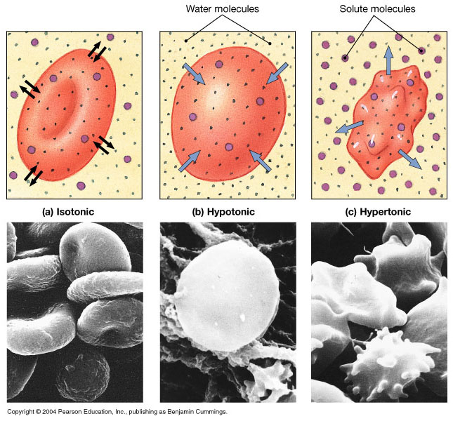
Osmotic flow across a cell membrane
Tonicity
The effects of osmotic solutions on cells
Isotonic : solute conc =cytosol solute conc, no net gain / loss of water
Hypotonic: solute conc more than cytosol solute conc, net gain of water into cell
Hypertonic = net water flow out of cell

Slide 49
Active Transport

Slide 50
Active Transport
Movement is Independent of concentration gradients (low to high/ high to low)
An energy-requiring process
energy from hydrolysis of ATP (1⁰)
energy stored in an ionic concentration gradient (2⁰)
Requires carrier proteins
Rate depends on the number of carriers and ATP
Types of active transport:
Primary active transport
Secondary active transport

Slide 51
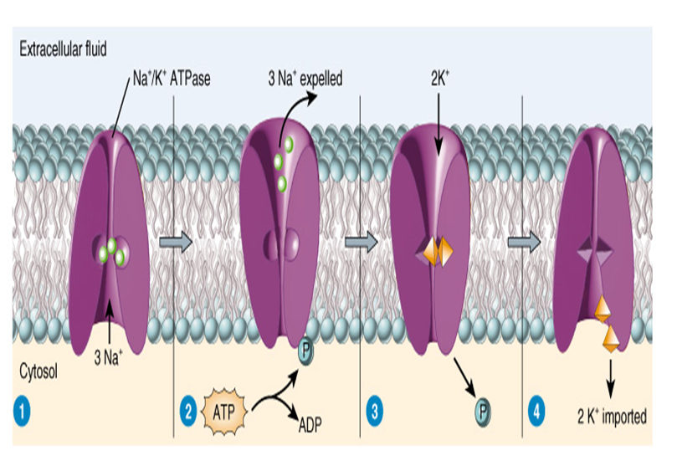
Primary Active Transport
Uses metabolic energy in the form of ATP and Ion pumps
Cells have 1000s of carrier (Transporter) proteins called ion pumps
operates continually
(Na⁺/K⁺ ATPase, Ca²⁺ ATPase pump)
Na+ binding
ATP split (phosphorylation)
Na+pushed out
K+ binding
Phosphate release
K+ is pushed in

Slide 52
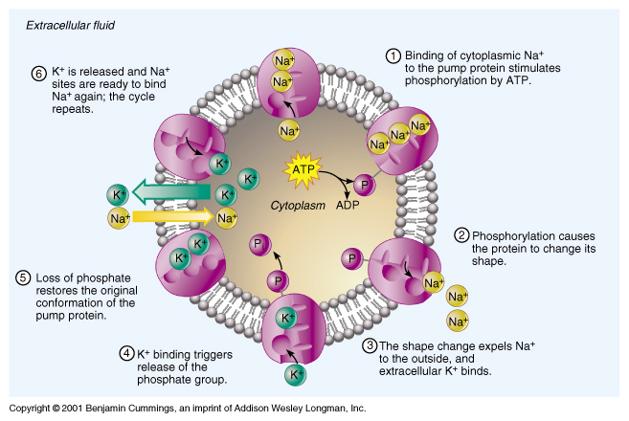
Sodium-Potassium Pump

Slide 53
Secondary Active Transport
Utilizes energy (stored in an ion concentration gradient) released during passive movement of one substance down its electrochemical gradient to transport another against its concentration gradient
Uses an exchange pump to indirectly drive the transport of other solutes
Eg, Na+/K+ pump maintains a low concentration of Na+ inside cells

Slide 54
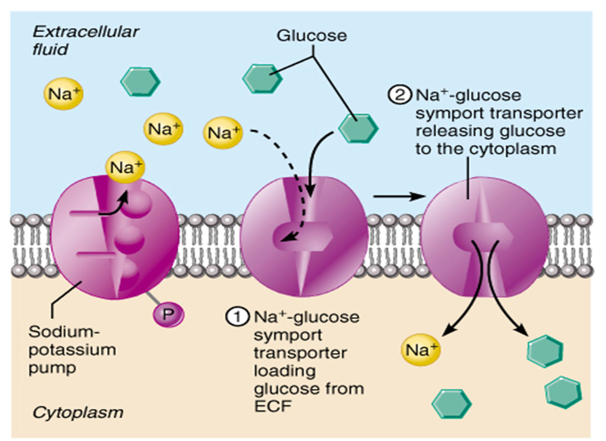
Eg. The Na+/K+ pump maintains a low concentration of Na+ inside cells
provide a route for Na+ to leak back in and use the energy of motion to transport other substances
Na+ symporter proteins
glucose or amino acids rush inward with Na+ ions
Na+ antiporter protein
as Na+ ions rush inward, Ca+2 or H+ pushed out

Slide 55
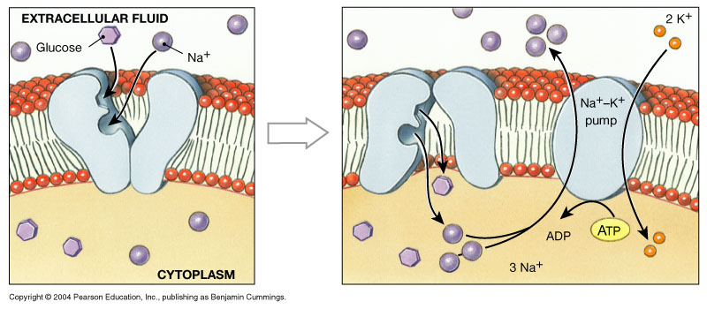

Slide 56
Vesicular transport
Transport of large particles and macromolecules across plasma membranes
Materials are bound in membranous vesicles
Types:
Exocytosis and
Endocytosis

Slide 57
Endocytosis(movement into the cell):
An energy-using process (Requires metabolic energy) by which cells absorb molecules by engulfing them. Eg proteins
Used by all cells as most of the important substances are large polar molecules that cannot pass through the hydrophobic plasma membrane.
Material to be taken into the cell is surrounded by a portion of the plasma membrane, buds off inside the cell to form a vesicle

Slide 58
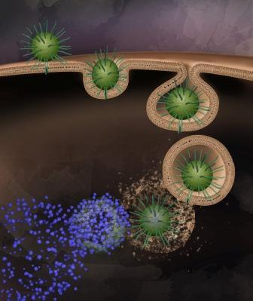

Slide 59
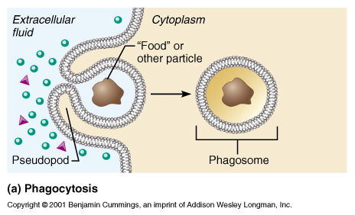
Types
Receptor-mediated endocytosis (coated vesicles)
Pinocytosis
Phagocytosis (pseudopodia): pseudopods engulf solids and bring them into the cell’s interior

Slide 60
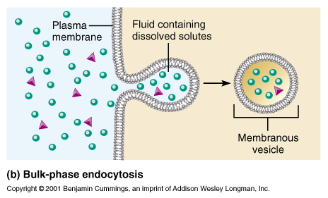
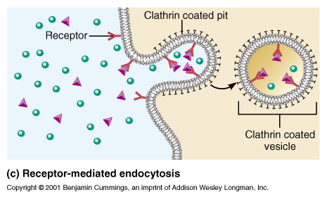

Slide 61
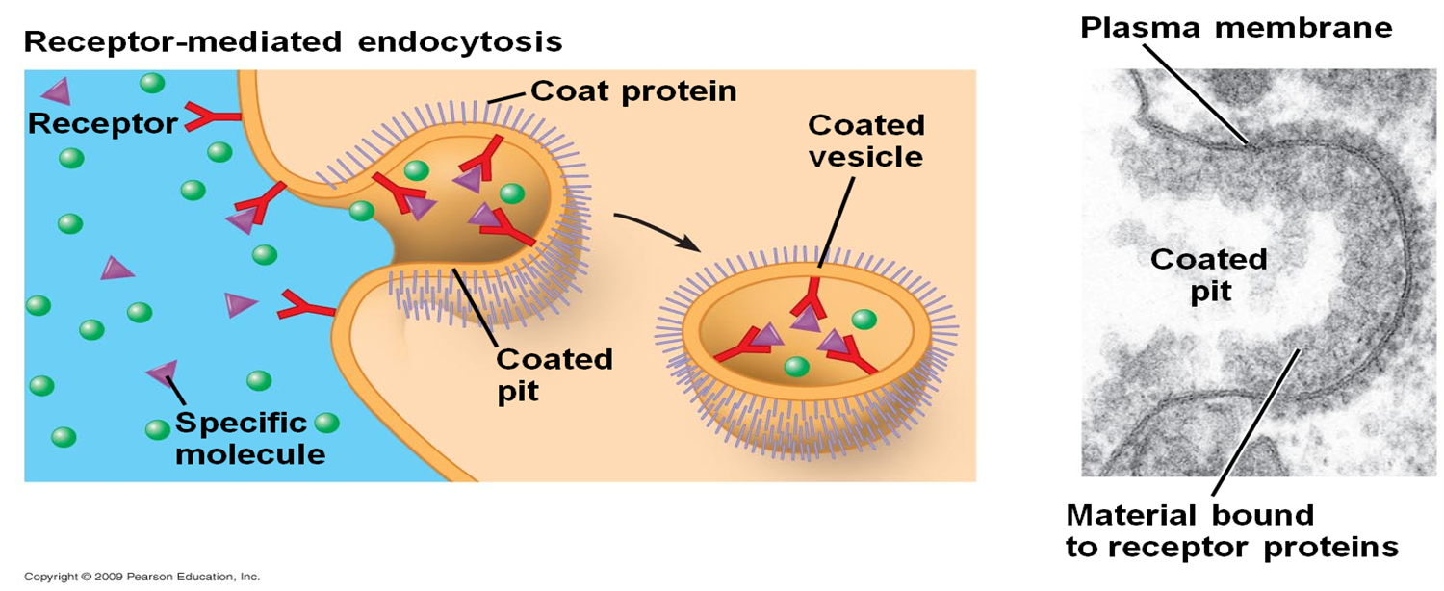
Receptor-Mediated Endocytosis
It is a process by which cells internalize molecules by endocytosis in which the inward budding of plasma membrane vesicles contains proteins with receptor sites specific to the molecules being internalized.

Slide 62
Pathway:
Specific target molecules (ligands) bind to plasma membrane-spanning receptors
A signal is sent through the membrane, leading to membrane coating, and formation of a membrane invagination.
Membrane coated ligands (receptor and its ligand) are then enclosed in (eg. clathrin-coated) vesicles.
As a pre-requisite for the vesicle to fuse with other membranes, the clathrin-coated vesicle uncoats
Vesicles fuse with 1⁰ lysosomes
Ligands are freed, broken down by enzymes
Diffuse into cytoplasm
Membrane of receptor molecules separate from membrane of lysosomes
Returns to cell surface to bind

Slide 63
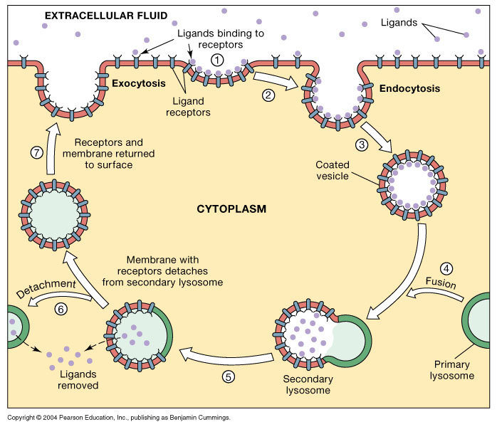

Slide 64
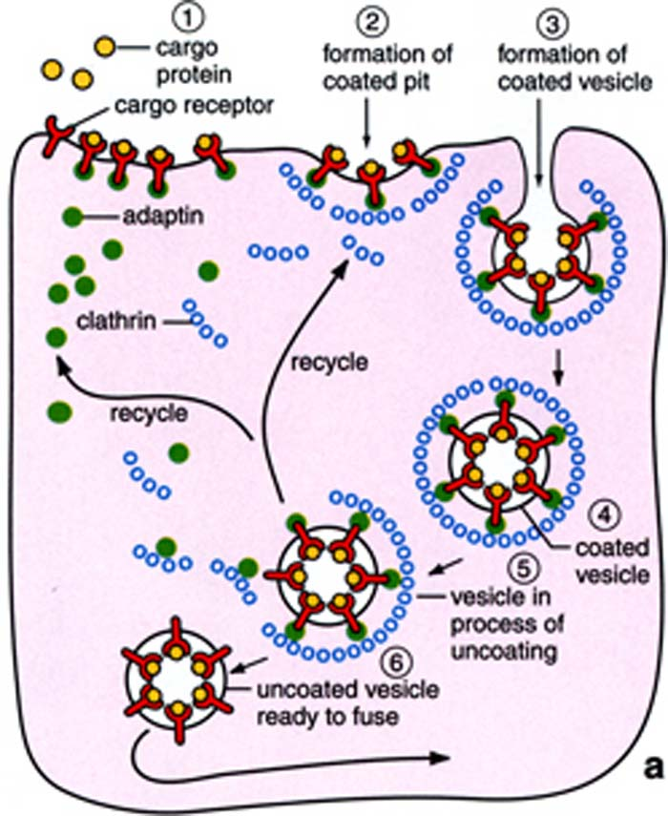

Slide 65
Pinocytosis
Used primarily for the absorption of extracellular fluids (Nonselective drinking of ECF)
“Cell drinking”
The cell takes in surrounding fluids, including all solutes present by engulfing already-dissolved or broken-down food.
Nonspecific in the substances that it transports
This process requires a lot of energy in the form of ATP

Slide 66
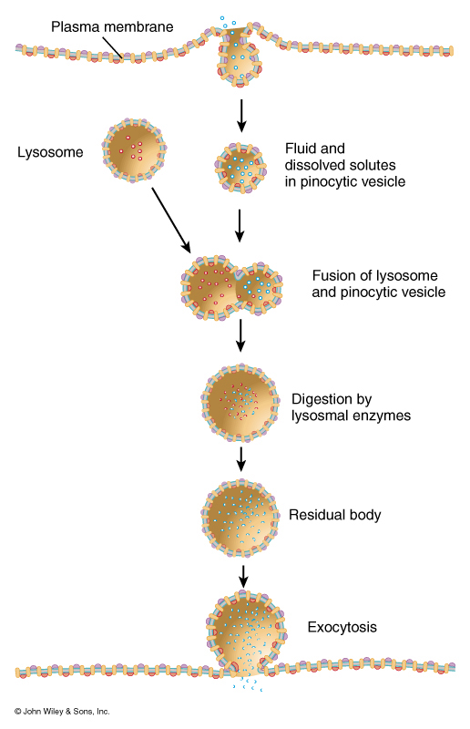
Pathway
Small particles are brought into the cell, forming an invagination
Pocket forms and pinches off
Particles are then suspended within small vesicles.
Pinocytotic vesicles fuse with lysosomes to hydrolyze (break down) the particles.

Slide 67
Phagocytosis
It is a specific form of endocytosis involving the vesicular internalization of solids.
It is the process by which a cell engulfs a solid particle to form an internal vesicle known as a phagosome.
Phagocytosis is specific in the substances it transports, engulfs whole particles, which are later broken down by enzymes and absorbed into the cells.
Importance:
Involved in the acquisition of nutrients for some cells (small mineral particles)
a major mechanism used to remove pathogens and cell debris (Bacteria, dead tissue cells)

Slide 68
Phagocytosis
It is a specific form of endocytosis involving the vesicular internalization of solids.
It is the process by which a cell engulfs a solid particle to form an internal vesicle known as a phagosome.
Phagocytosis is specific in the substances it transports, engulfs whole particles, which are later broken down by enzymes and absorbed into the cells.
Importance:
Involved in the acquisition of nutrients for some cells (small mineral particles)
a major mechanism used to remove pathogens and cell debris (Bacteria, dead tissue cells)

Slide 69
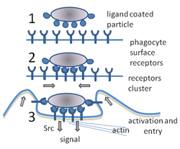
Pathway:
To trigger phagocytosis, ligand coated particles bind to phagocyte surface receptors
Binding of receptors causes them to cluster.
Phagocytosis is triggered
Pseudopods extend to form phagosome
particle is taken up by the phagocyte

Slide 70
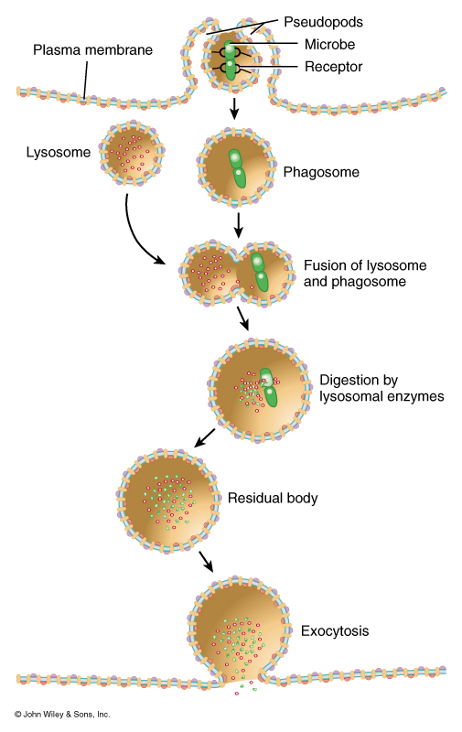
Material is brought into cell is enclosed in the phagosome
Lysosome fuses with the phagosome
Exposed to lysosomal enzymes: digest the particles
Residue is discharged

Slide 71
Exocytosis
It is the ejection/discharge of materials from the cell to the extracellular space
Process by which materials packed in vesicles are secreted from a cell when the vesicle membrane fuses with the plasma membrane
Ejected material may be secretory, waste or products accumulating in endocytic vesicles
Requires energy and Ca²⁺

Slide 72
Exocytosis is ejection/discharge of materials from the cell to the extracellular space
Process by which materials packed in vesicles are secreted from a cell when the vesicle membrane fuses with the plasma membrane
Ejected material may be secretory, waste or products accumulating in endocytic vesicles
Requires energy and Ca²⁺

Slide 73
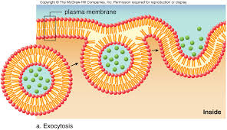

Slide 74
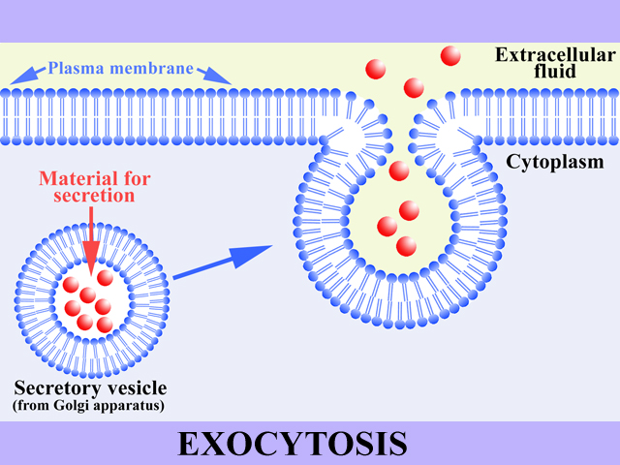

Slide 75
Filtration
The passage of water and solutes through a membrane by hydrostatic pressure
Pressure gradient pushes solute-containing fluid from a higher-pressure area to a lower-pressure area
amount of fluid filtered is proportionate to:
The pressure difference
Surface area of the membrane
permeability of the membrane

